Slide 1
CPSC440 Computer System Architecture II
Dr. Ning Chen, Ph.D.
Professor, Department of Computer Science
California State University, Fullerton

Slide 2
Chapter 1
Computer Abstractions and Technology

Slide 3
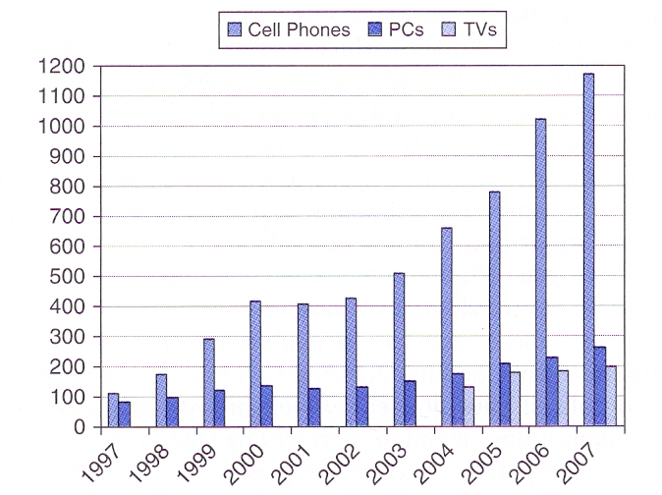
Market for different computers

Slide 4
Measuring Performance
CPU execution time for a program =
(CPU clock cycles for a program) x (Clock cycle time)
= (CPU clock cycles for a program)/(Clock rate)

Slide 5
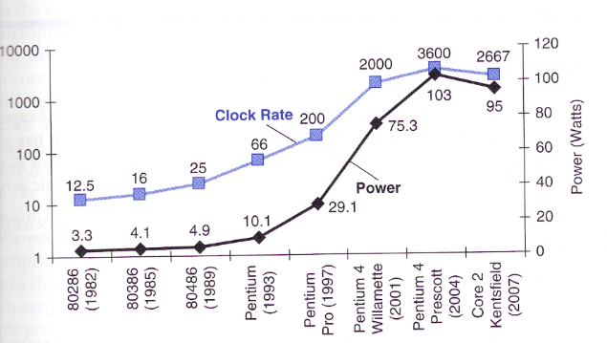
Power consumption of CPU

Slide 6
Power equation
Power = Capacitive load X Voltage² X Frequency switched

Slide 7
Example (page 34)
Our favorite program runs in 10 seconds on computer A, which has 2 GHz clock. We are trying to help a computer designer build a computer B, which will run this program in 6 seconds. The designer has determined that a substantial increase in the clock rate is possible, but this increase will affect the rest of the CPU design, causing computer B to require 1.2 times as many clock cycles as computer A for this program. What clock rate should we tell the designer to target?

Slide 8
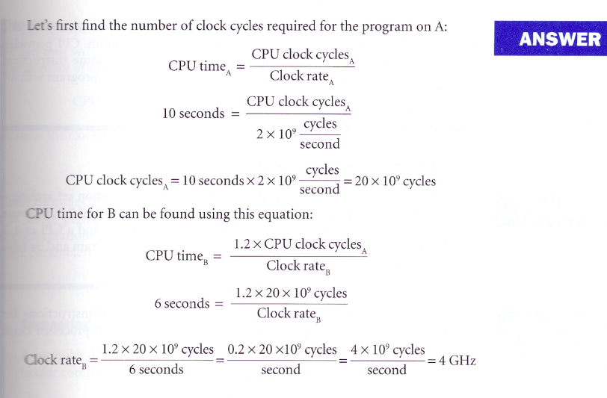
Answer

Slide 9
Fallacies and Pitfalls
Commonly held misconceptions – Fallacies
Easily made mistakes - pitfalls

Slide 10
Pitfall
Expecting the improvement of one aspect of a computer to increase overall performance by an amount proportional to the size of the improvement.

Slide 11
Pitfall example
Suppose a program runs in 100 seconds on a computer, with multiply operations responsible for 80 seconds of this time. How much do I have to improve the speed of multiplication if I want my program to run five times faster?

Slide 12
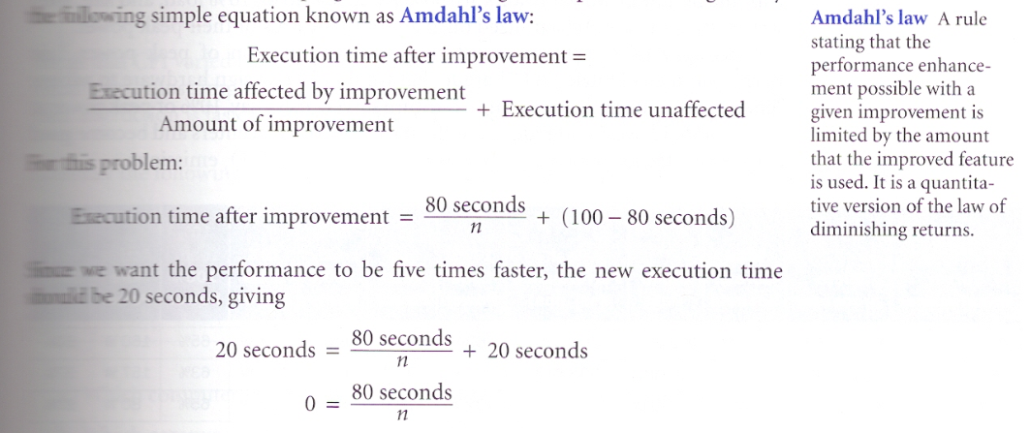
Approach

Slide 13
Fallacy example
Computers at low utilization use little power.

Slide 14
Pitfall example (another)
Using a subset of the performance equation as a performance metric.

Slide 15
MIPS
MIPS, for Microprocessor without interlocked pipeline stages, is a RISC microprocessor architecture developed by MIPS Computer Systems Inc. (From Wikipedia, the free encyclopedia.)

Slide 16
MIPS (Million Instructions Per Second)
MIPS= (Instruction count)/(Execution time x 10⁶)
CPI = Clock Cycles Per Instruction
Measurement | Computer A | Computer B
Instruction Counts | 10 billion | 8 billion
Clock Rate | 4 GHz | 4 GHz
CPI (averaged) | 1.0 | 1.1

Slide 17
Which computer has the higher MIPS rating?

Slide 18
Approach
Computer A can run 4 G clock cycles per second. Since CPI=1, that means this computer can run 4G instructions per second (which is 4000 Million Instructions Per Second, thus, 4000 MIPS)

Slide 19
Approach
Computer B can run 4 G clock cycles per second. Since B’s CPI=1.1, that means in one second, B executes 4G/1.1 = 3.64 x 10⁹ instructions = 3640 Million Instruction Per Second = 3640 MIPS.

Slide 20
Which computer is faster?

Slide 21
Approach
How many clock cycles needed for computer A to finish the program: 10 B x CPI = 10 x 10⁹ x 1 = 10¹⁰ cycles
How many seconds needed for computer A to finish the job? (10¹⁰ cycles/4G cycles =10 x 10⁹ / 4 x 10⁹ = 2.5 seconds

Slide 22
Approach
How many clock cycles needed for computer B to finish the program: 8 B x CPI = 8 x 10⁹ x 1.1 = 8.8 x 10⁹ cycles
How many seconds needed for computer B to finish the job?
8.8 x 10⁹ cycles /4G cycles =8.8 x 10⁹ / 4 x 10⁹ = 2.2 seconds

